Slide 1
IDENTIFYING RATIONAL AND IRRATIONAL NUMBERS

Slide 2
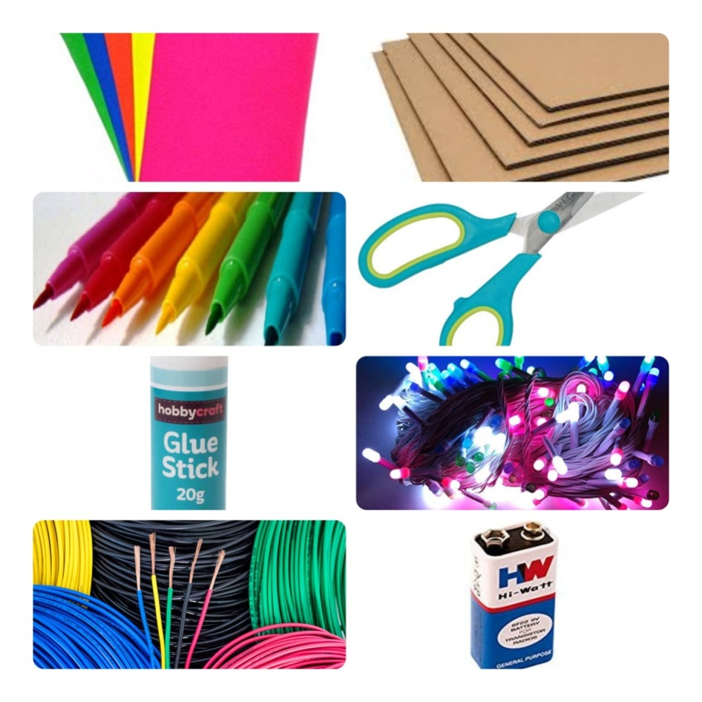
MATERIALS REQUIRED
Cardboard
Chart
Sketch pens
Scissor
LED lights
Glue
Battery and wires

Slide 3
Plan of action
A Math model is prepared with the help of above mentioned materials.

Slide 4
If the chosen number is correct then the green LED will glow with the pleasant music arise , otherwise red LED will glow with rasping sound.

Slide 5
(Same case for irrational numbers)

Slide 6
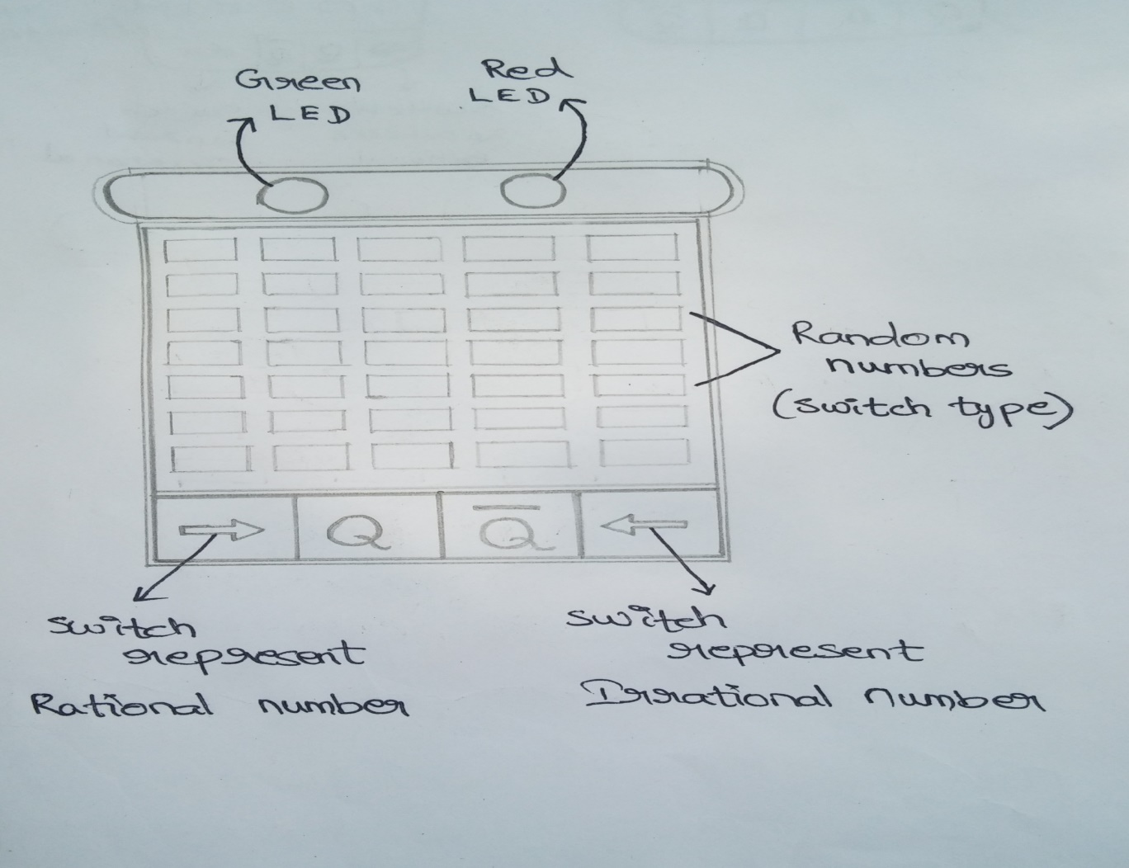
prototype

Slide 7

THANK YOU

